Slide 1



Slide 2

Past
Present
& Future

Slide 3


Dzmitry Varabei aka “Dean”
8+ years of Software Development in EPAM
6 years in education and knowledge sharing as CDP/RD trainer
3 years in community building
Dzmitry Varabei
EPAM Systems, Chief Software Engineer

Slide 4
Afterwords

Slide 5

Community building

Slide 6


Slide 7


Slide 8
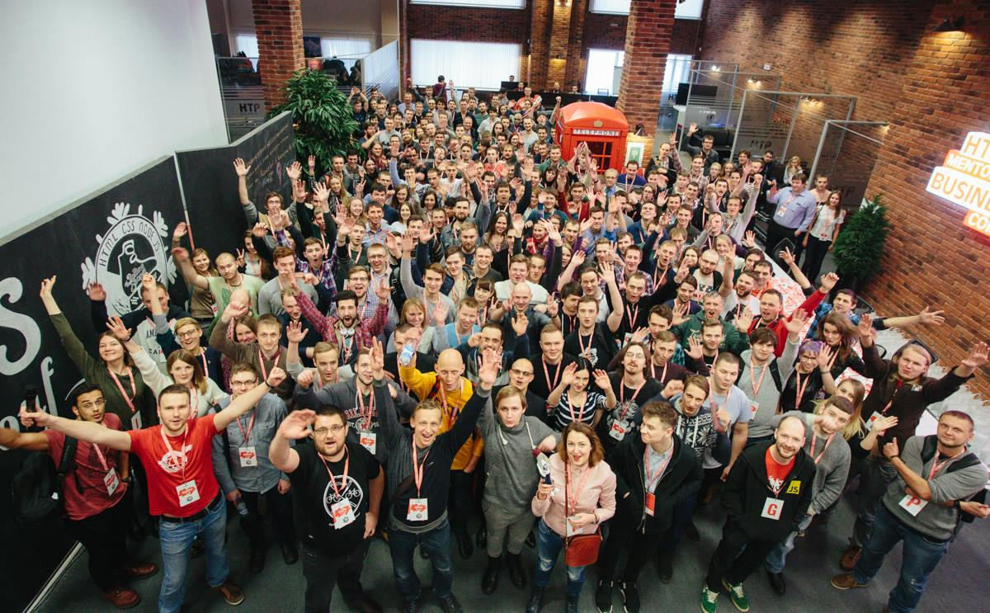
Prologue

Slide 9
"The Rolling Scopes" - a non-profit JavaScript/Front-end community

Slide 10
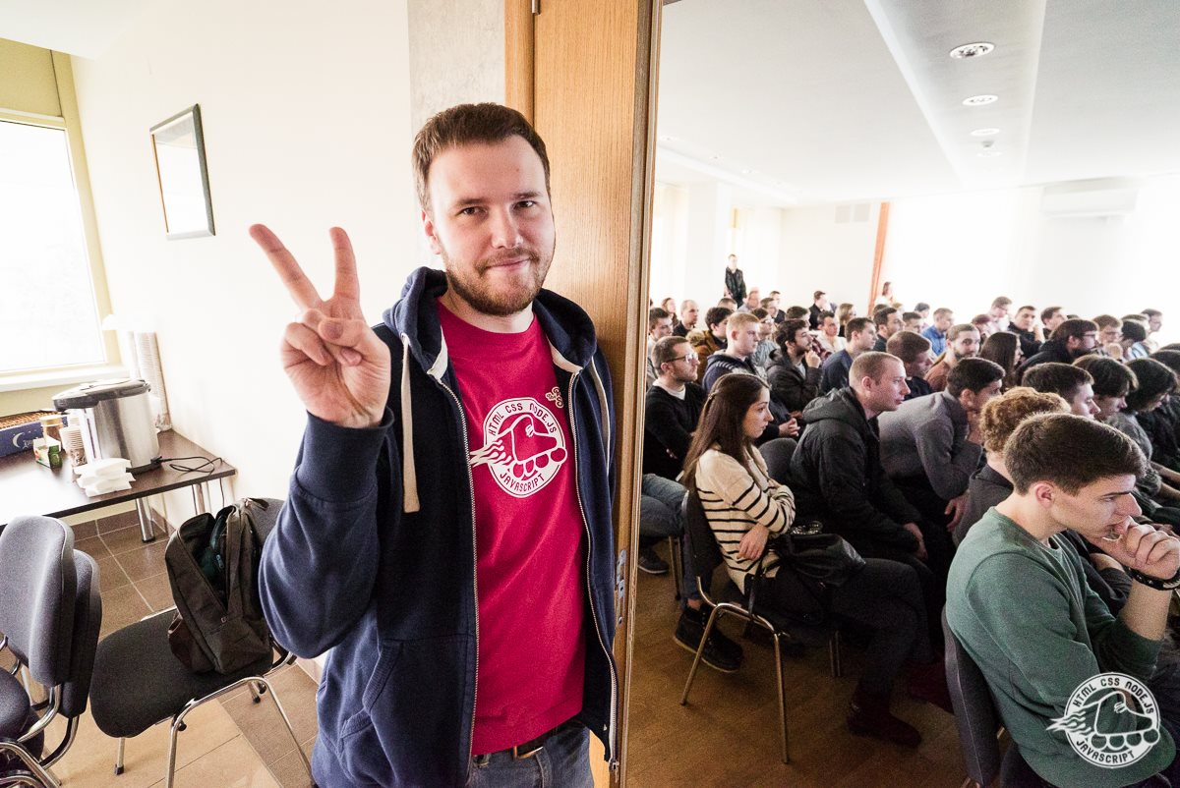
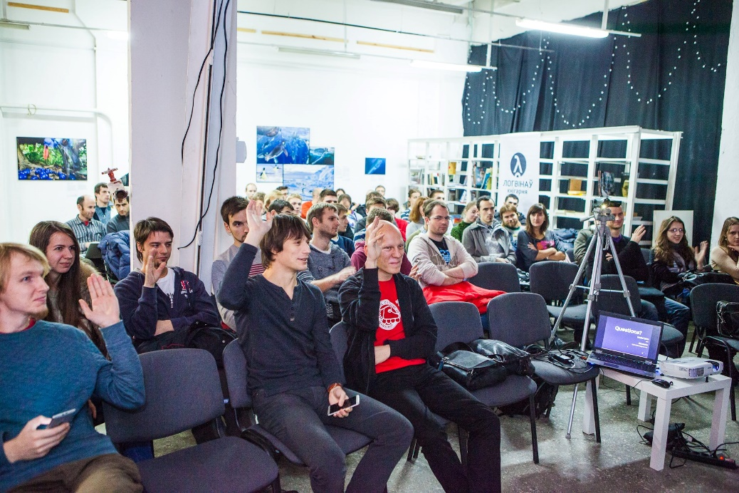
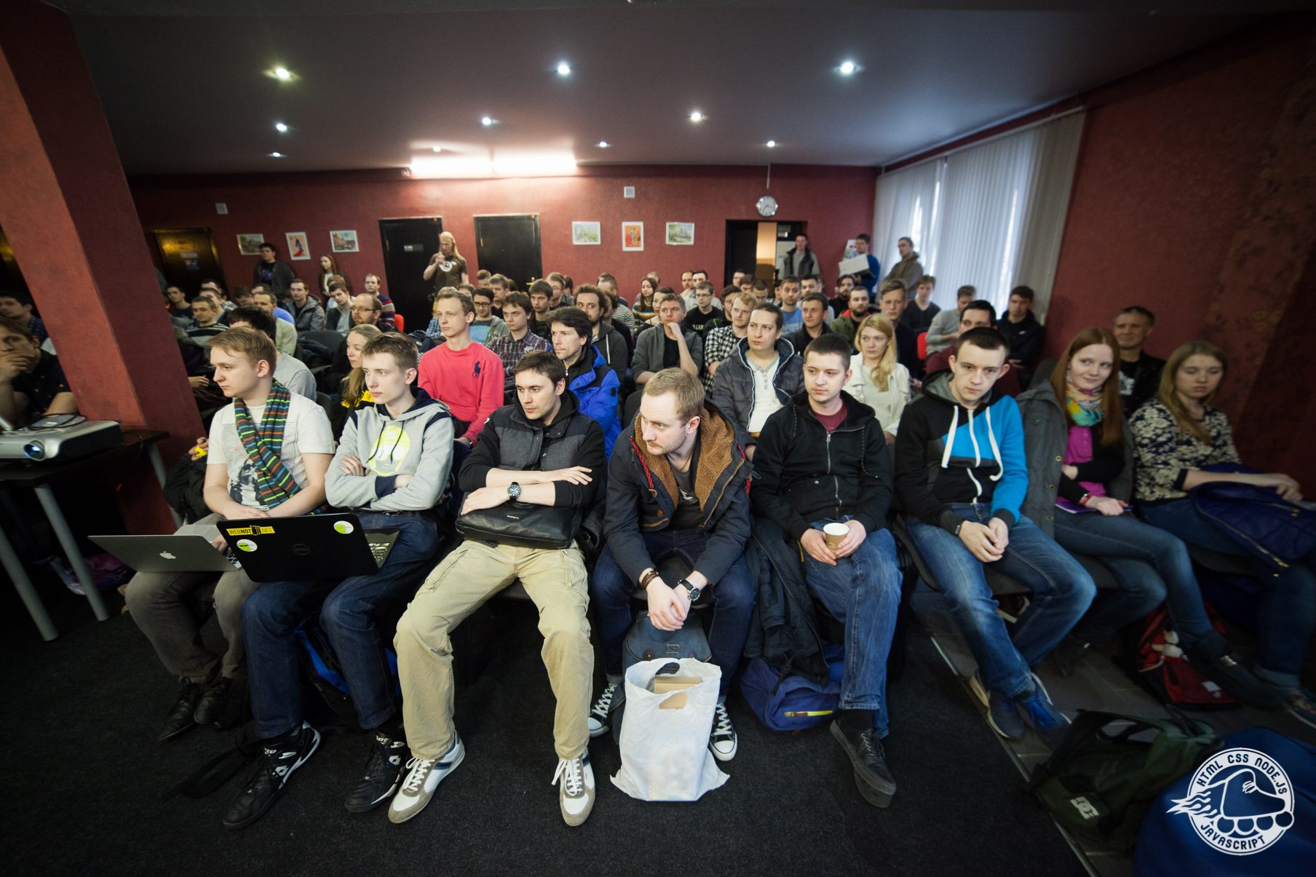
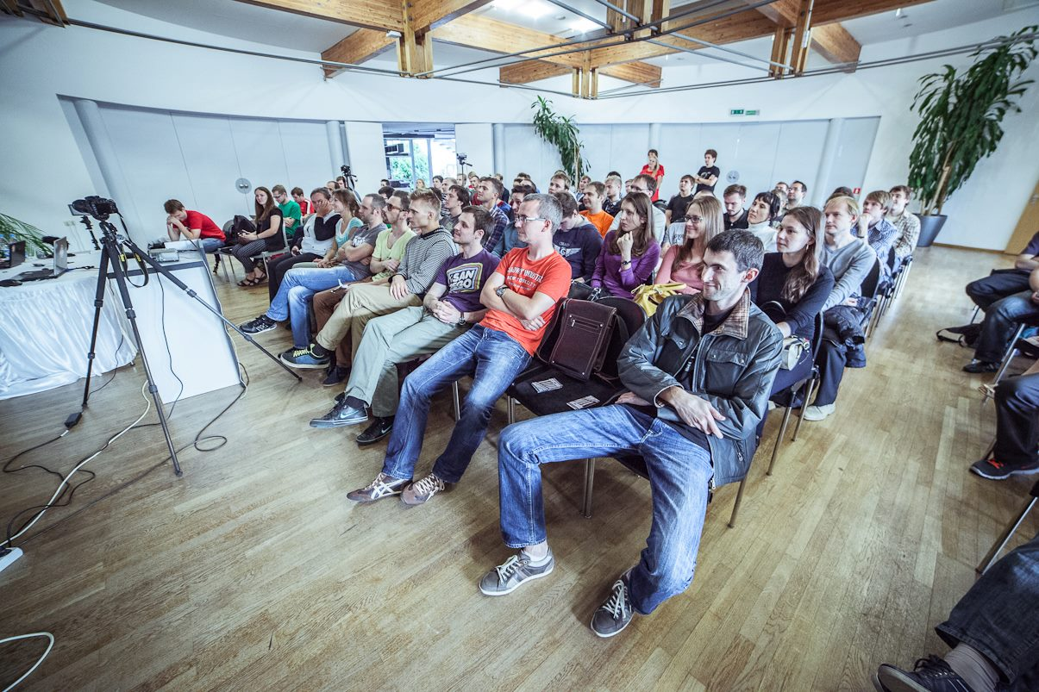
25+ Meetups 60+ Speakers 110+ Talks

Slide 11
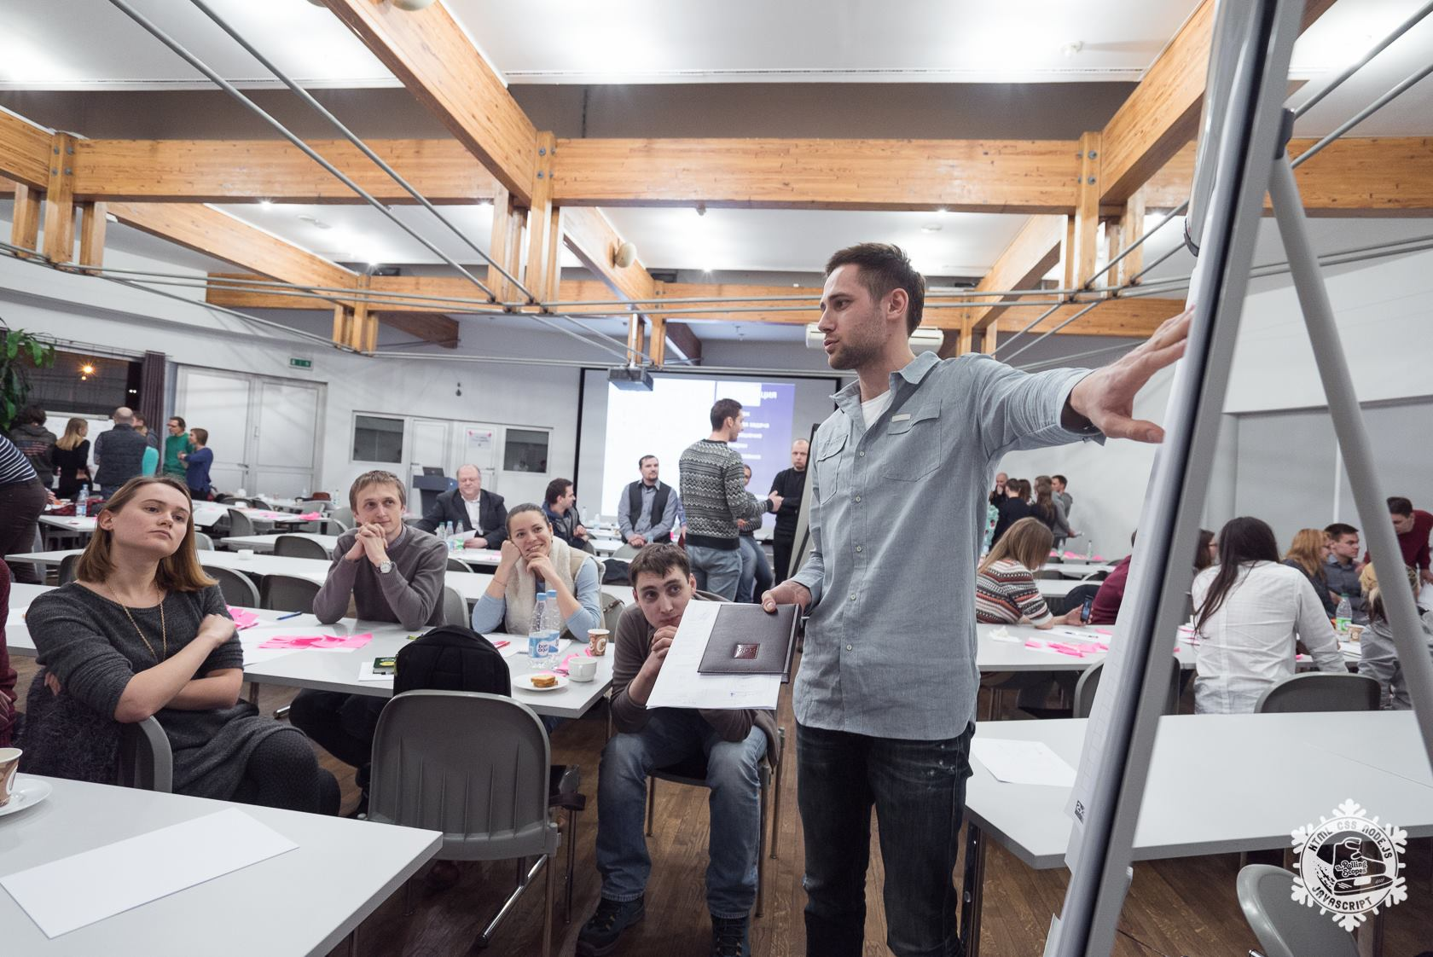
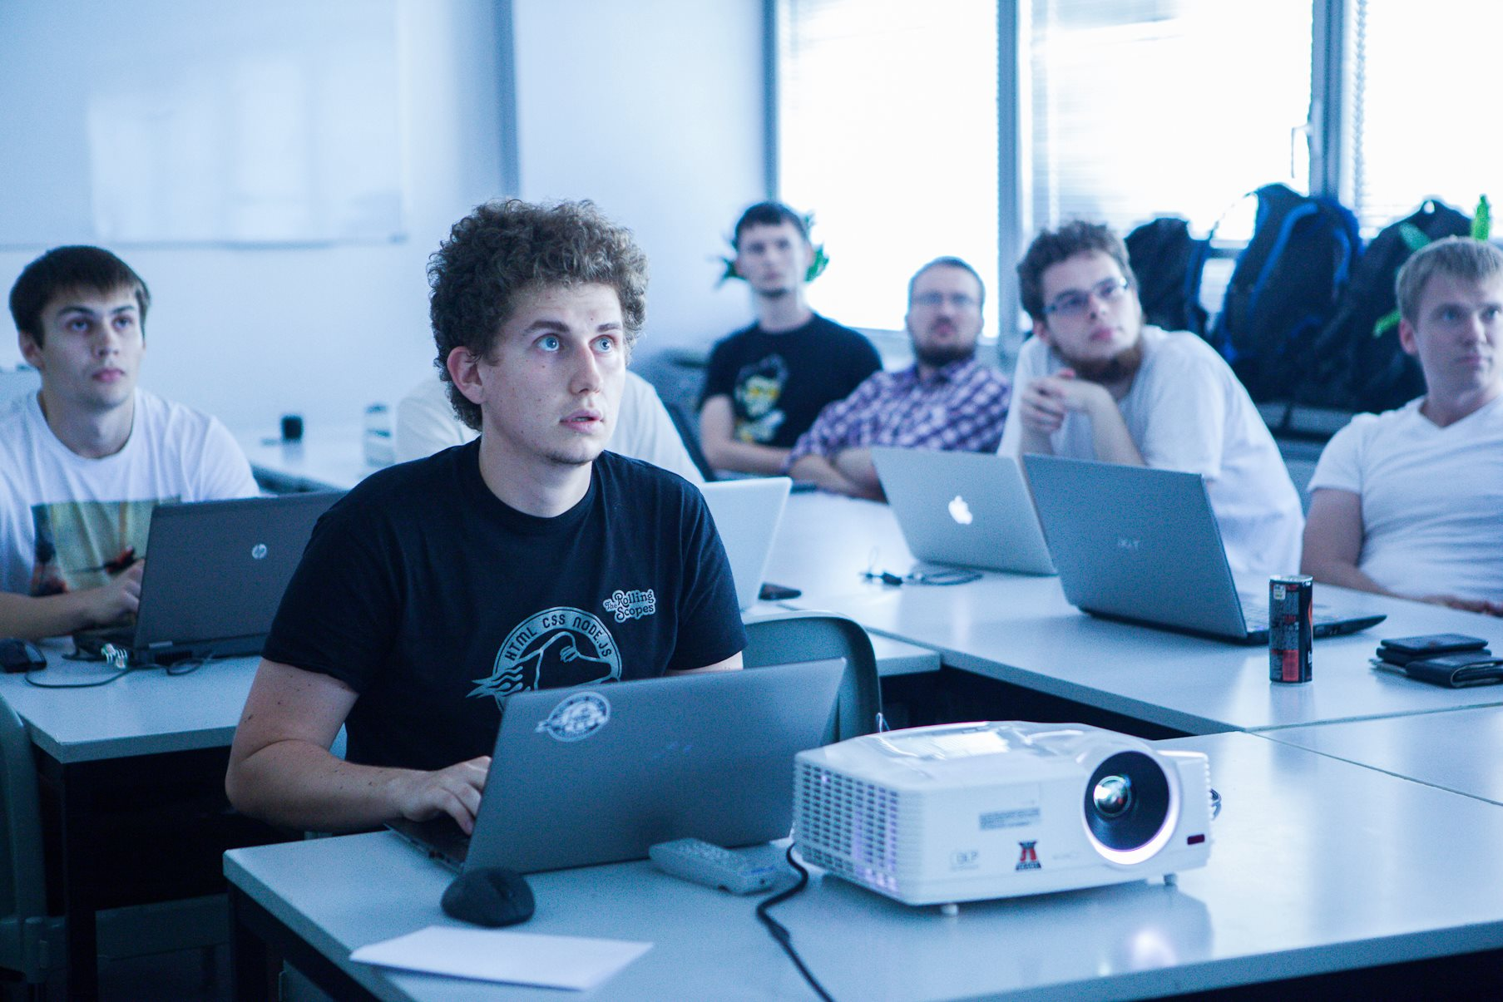
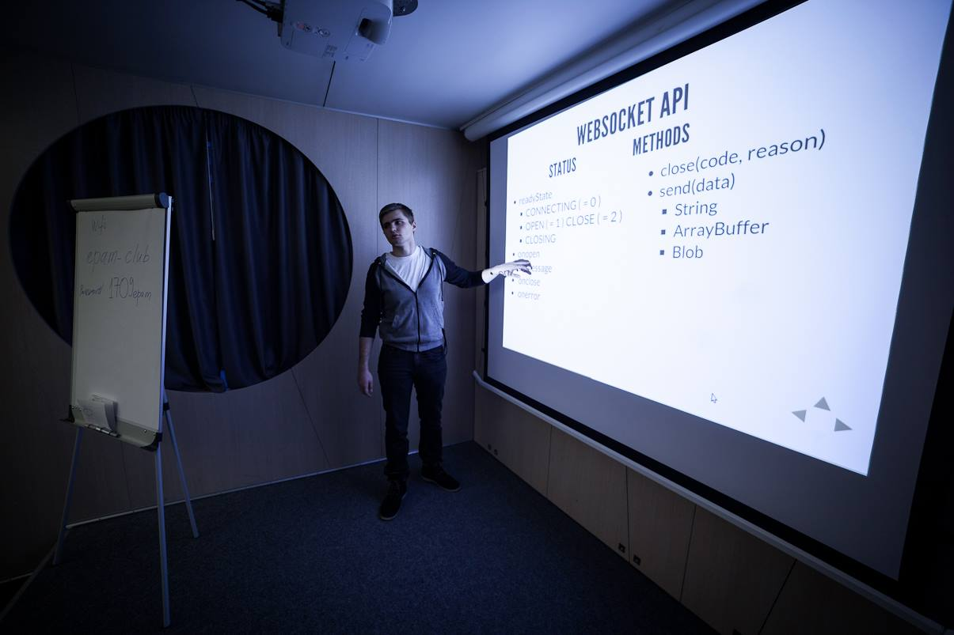
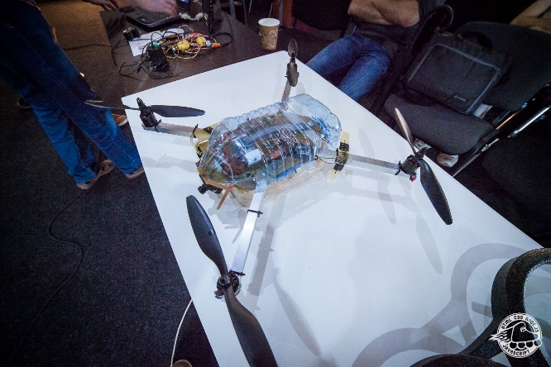
10+ Workshops

Slide 12
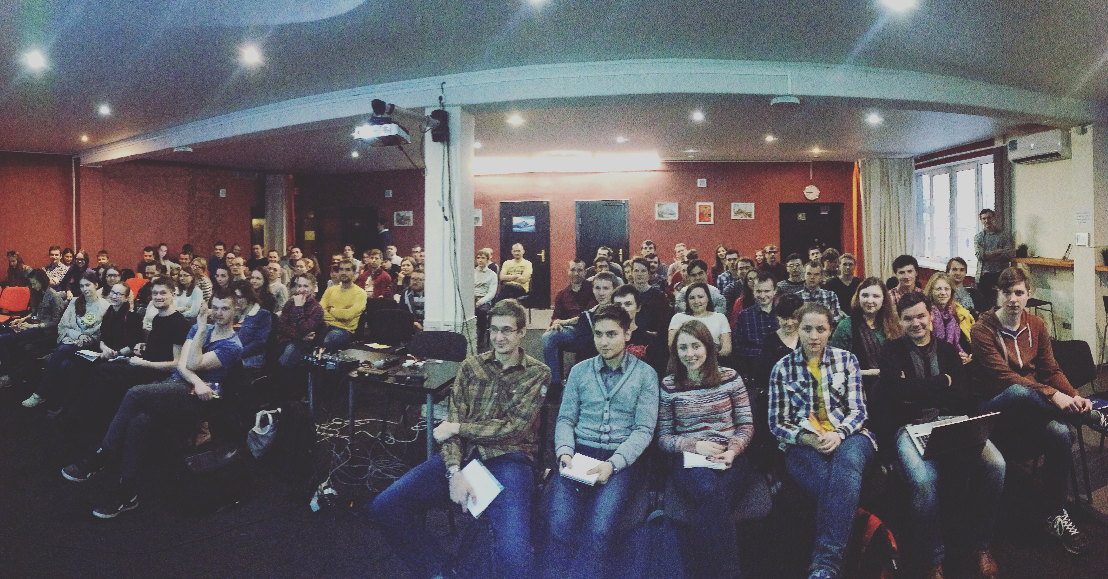
RS SChool

Slide 13

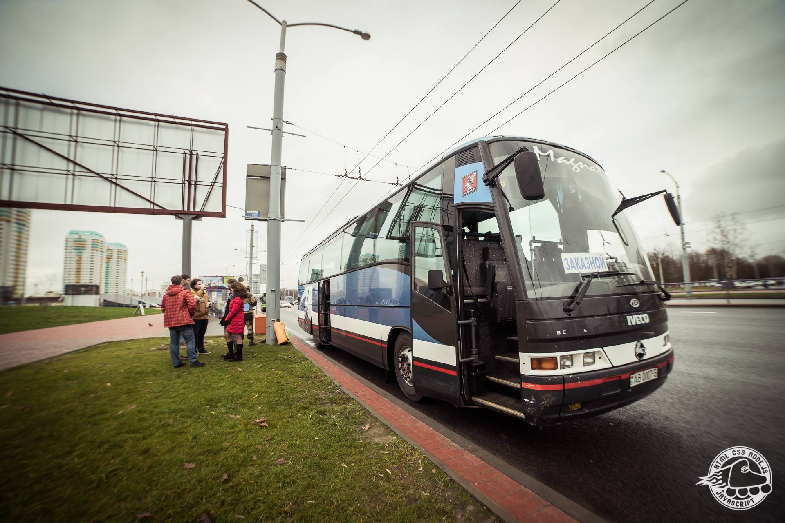
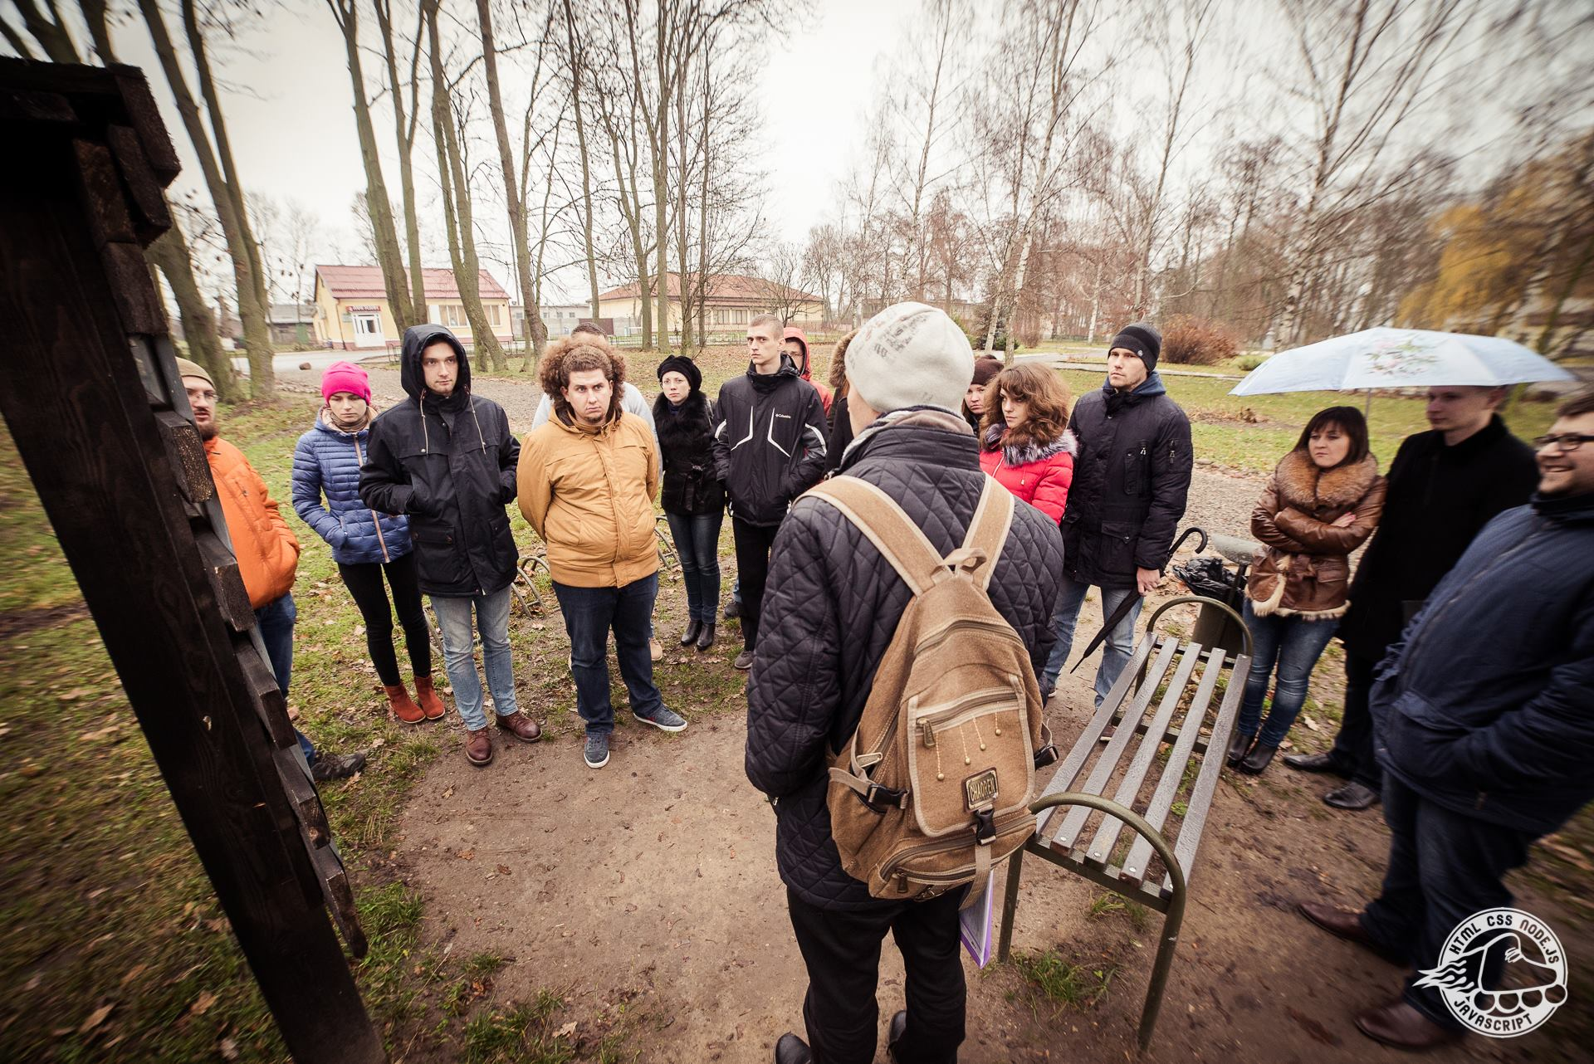
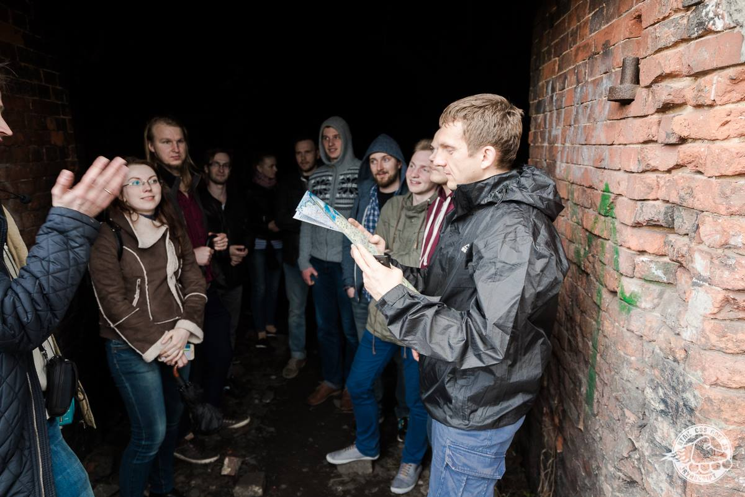
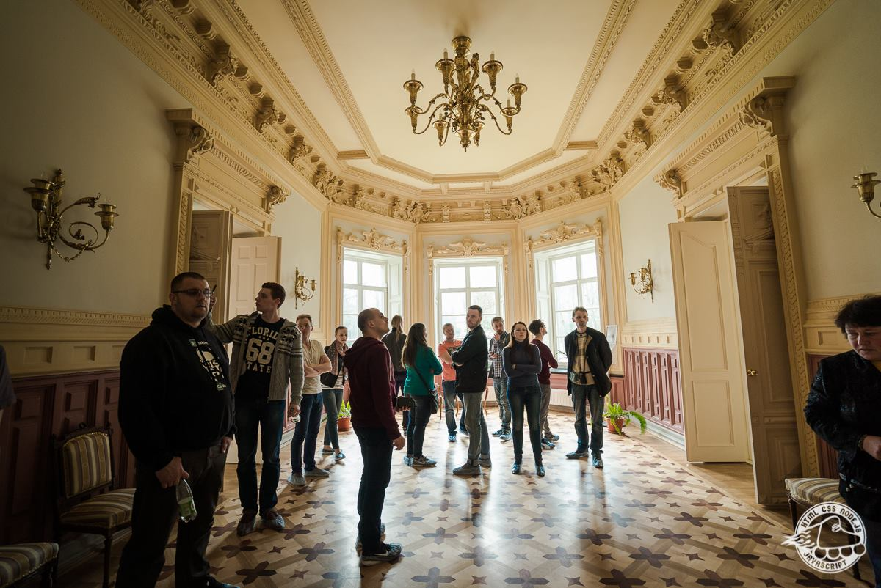

Slide 14
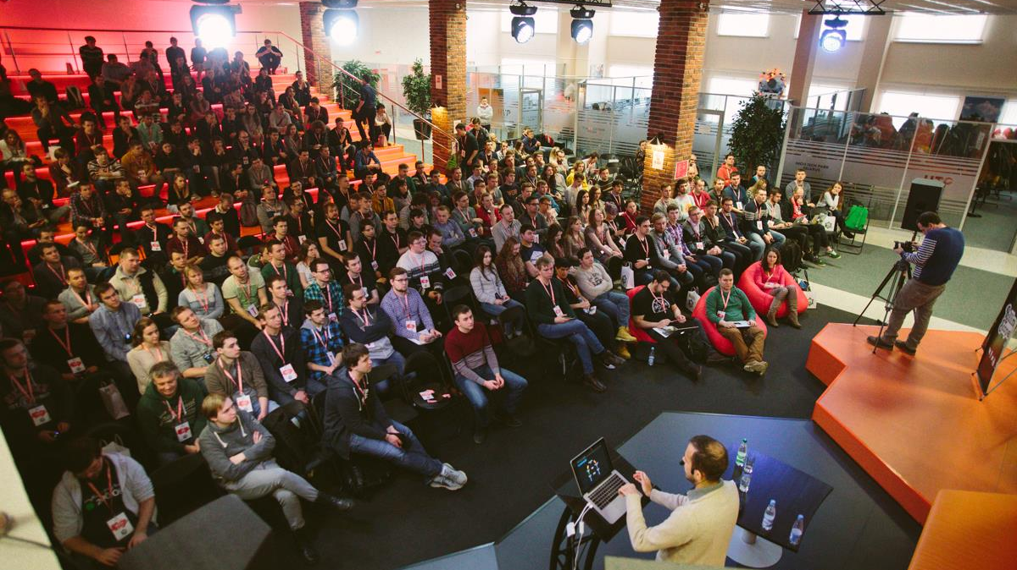

THE ROLLING SCOPES CONFERENCE 2016
FEBRUARY 18-21

Slide 15




Community?

Slide 16
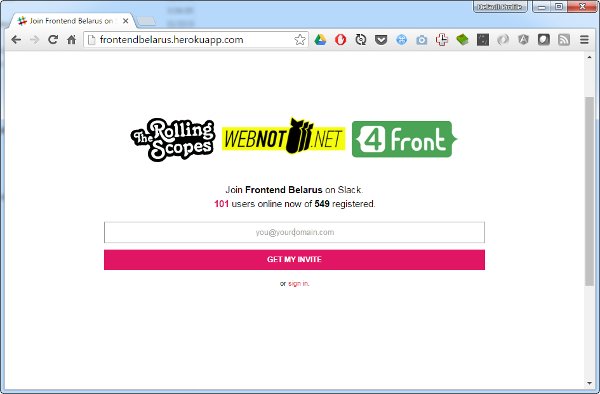
SLACK

Slide 17
Chapter I. Birth

Slide 18
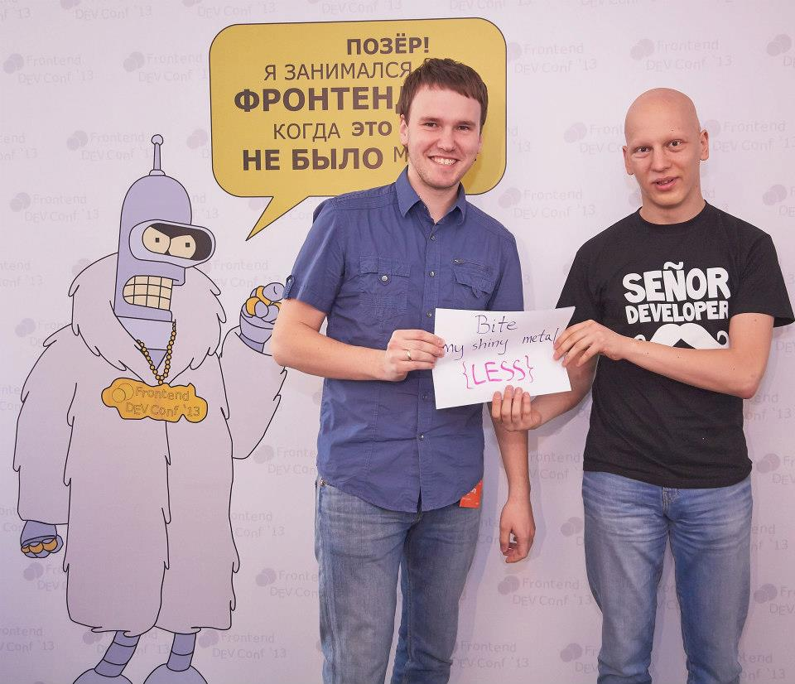
#FDConf 2013

Slide 19
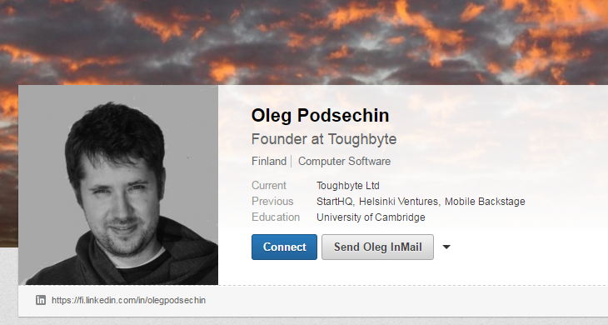

Slide 20


Slide 21


Slide 22

Chapter II. Crew

Slide 23
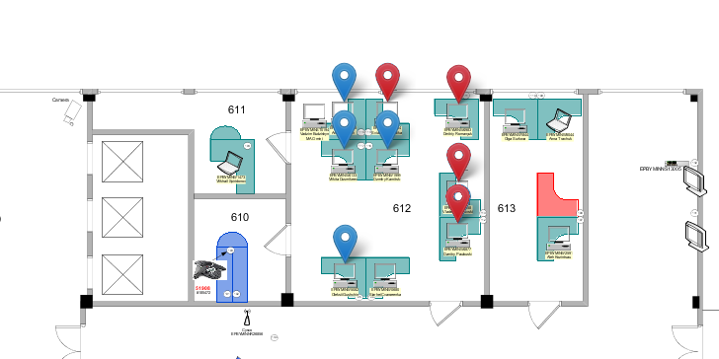
RTRS-MLTM, Insider SDK
May, 2013
Belarus, Minsk, Radialnaya, 40, 612

Slide 24
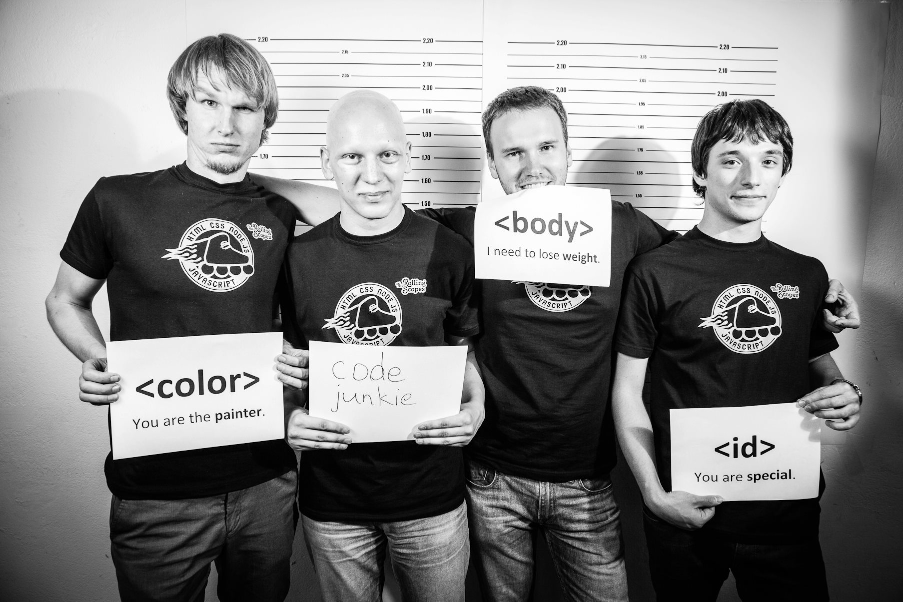
RS Crew
21-MAY-2013

Slide 25
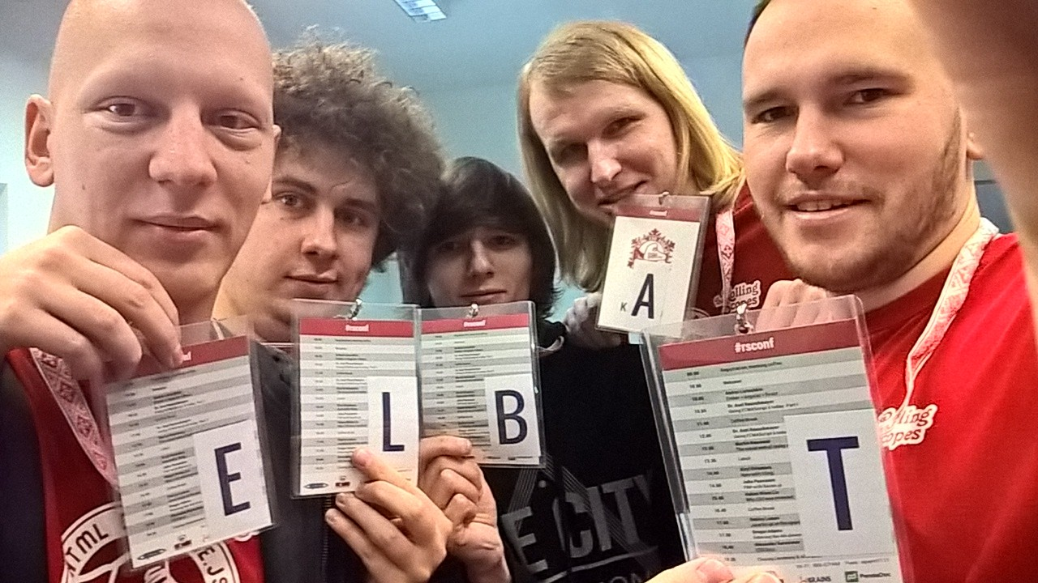
RS Crew
2015

Slide 26
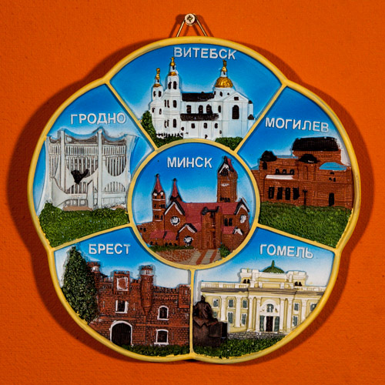
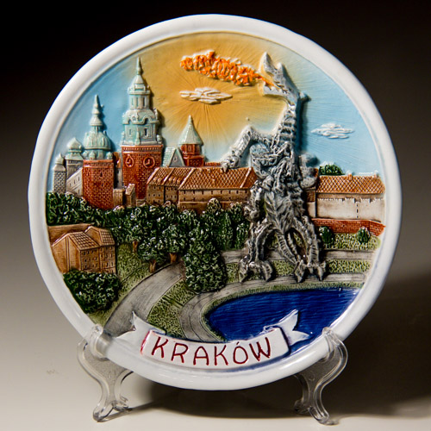

Slide 27

Chapter III. LOGO & Name

Slide 28

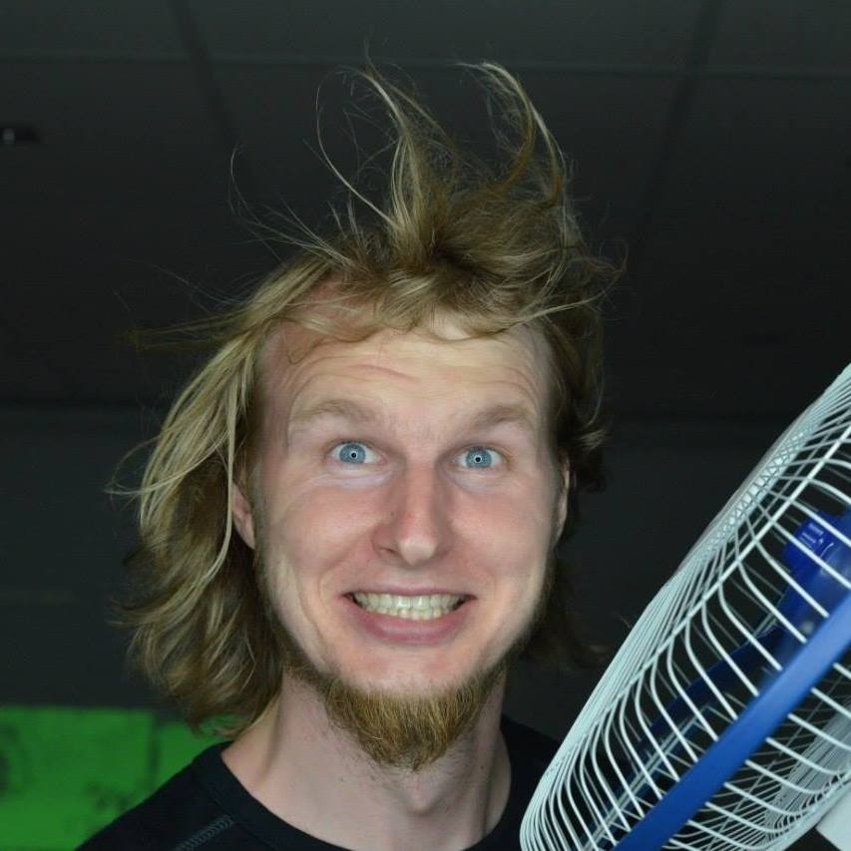
Aliaksandr Karlovich

Slide 29
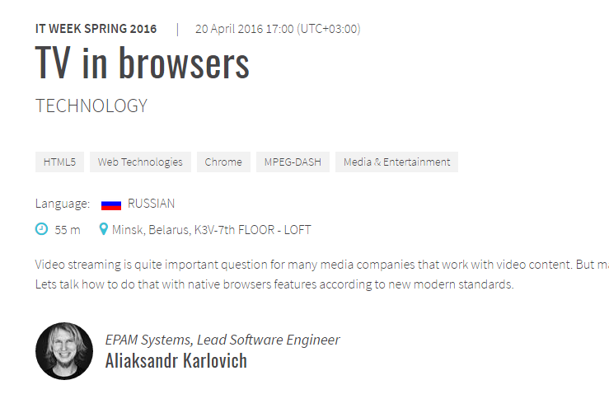

Slide 30


Slide 31
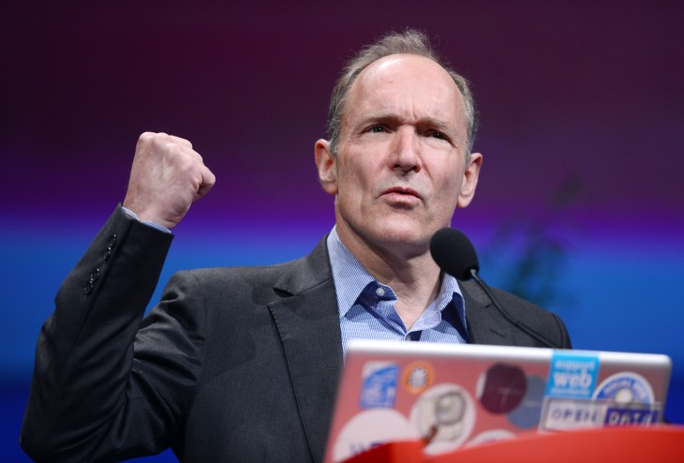

Slide 32
Our Scope
HTML
CSS
JS
Node.js

Slide 33
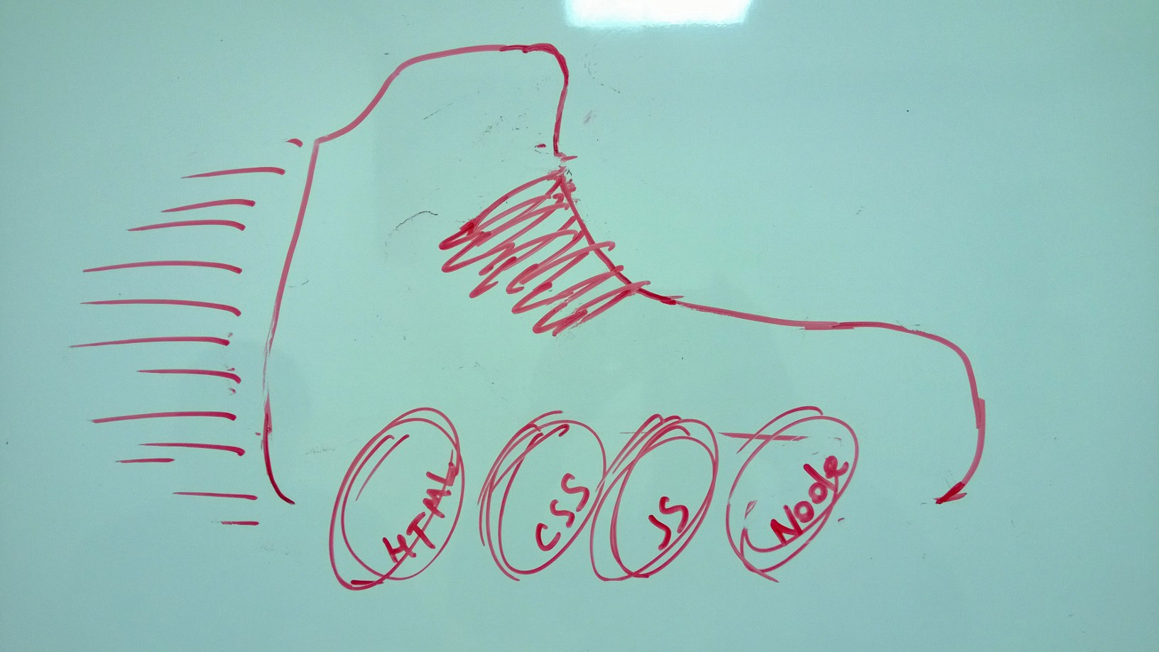
HTML
CSS
JS
Node.js

Slide 34

Design #1

Slide 36
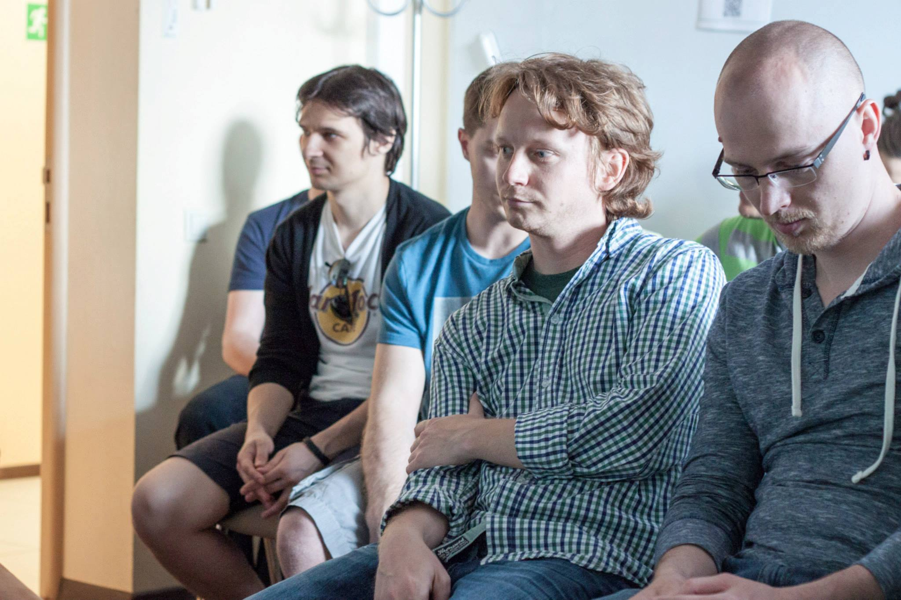

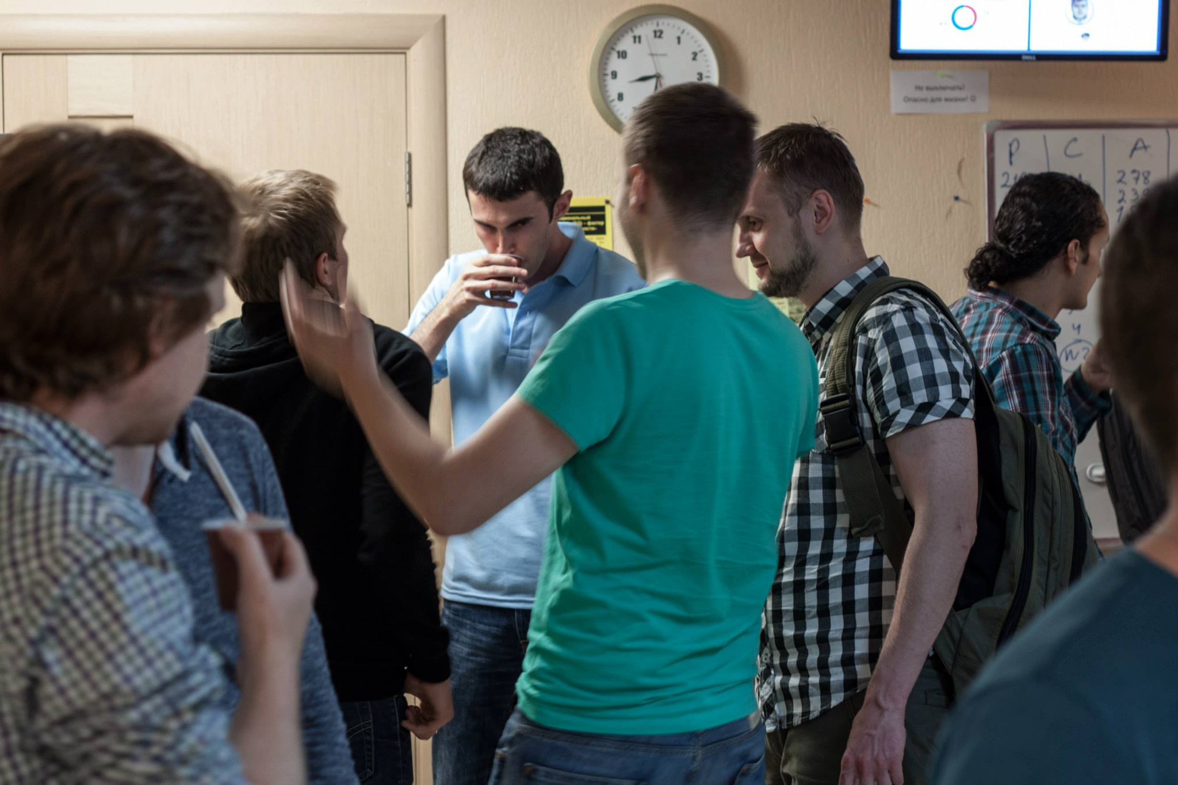
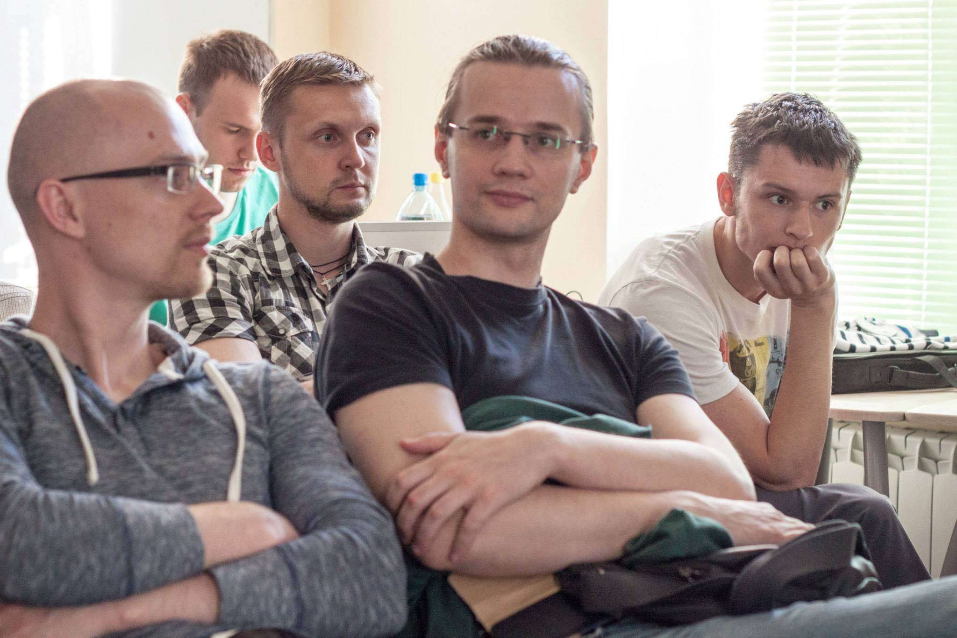
Chapter IV. RS#1

Slide 37
How to find a speaker?

Slide 38
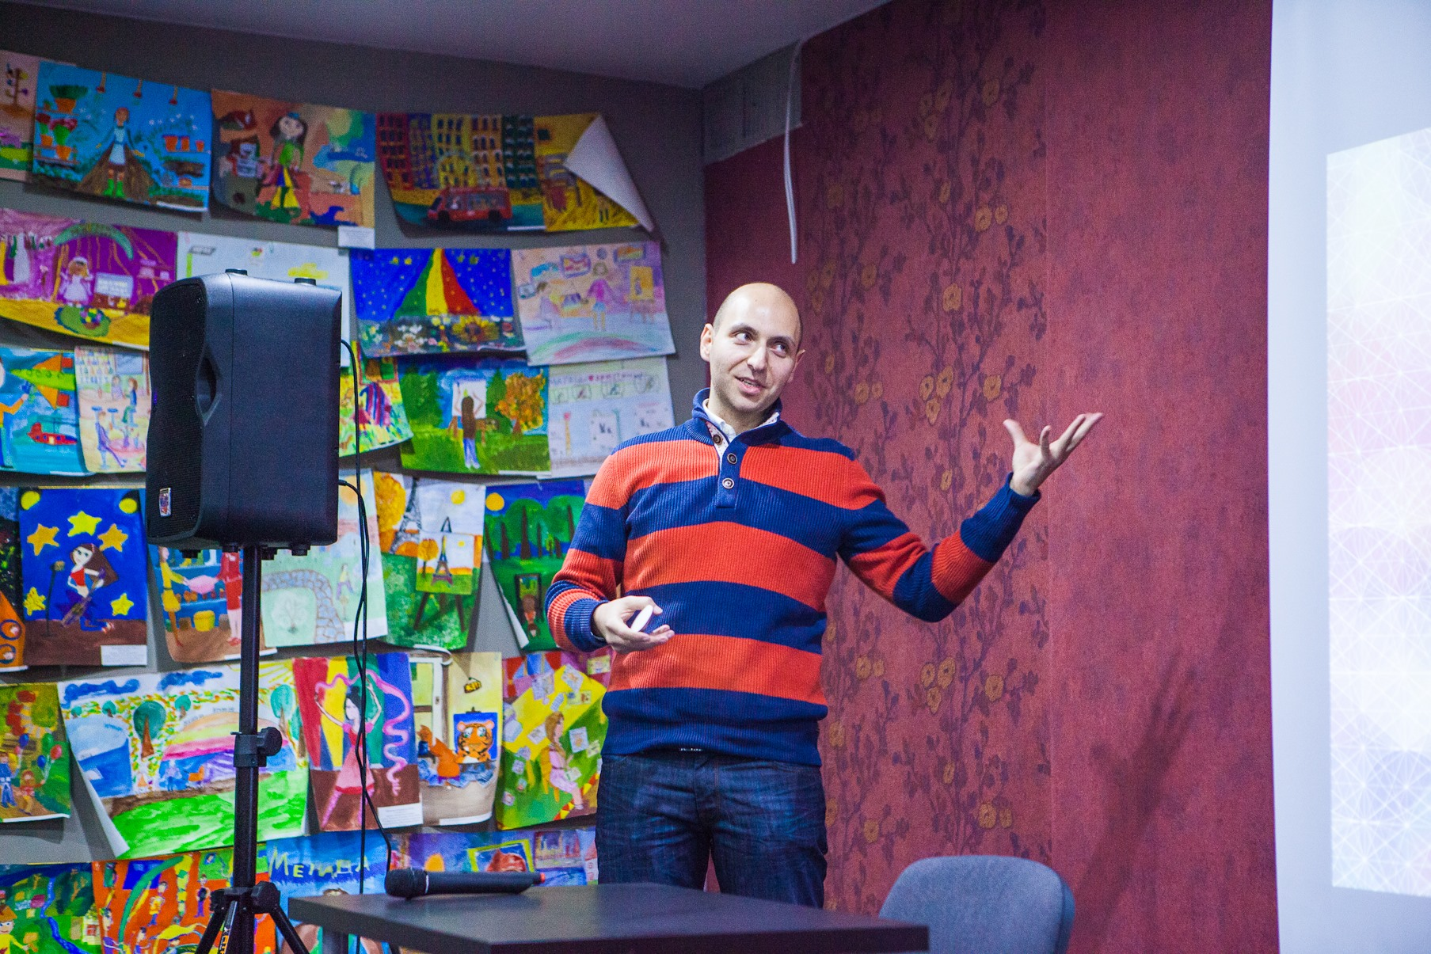

Little Trick

Slide 39
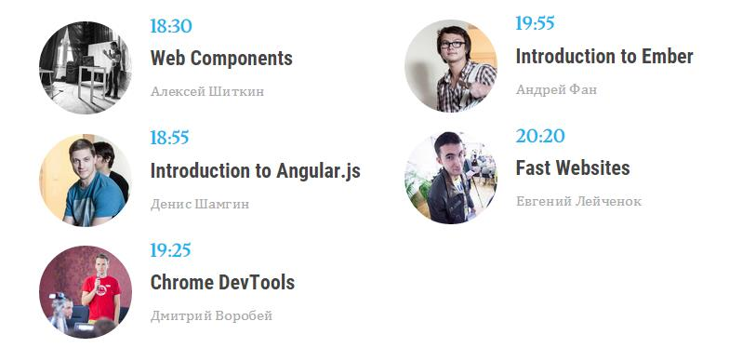
RS #1
21-MAY-2013

Slide 40
Budget?
No

Slide 41
The Rolling Scopes #1
Venue
Room - Minsk, N58, 409, Ariel - for Conference
Skype groups
Facebook, VK, Twitter, dev.by
Posters
Advertisements

Slide 42
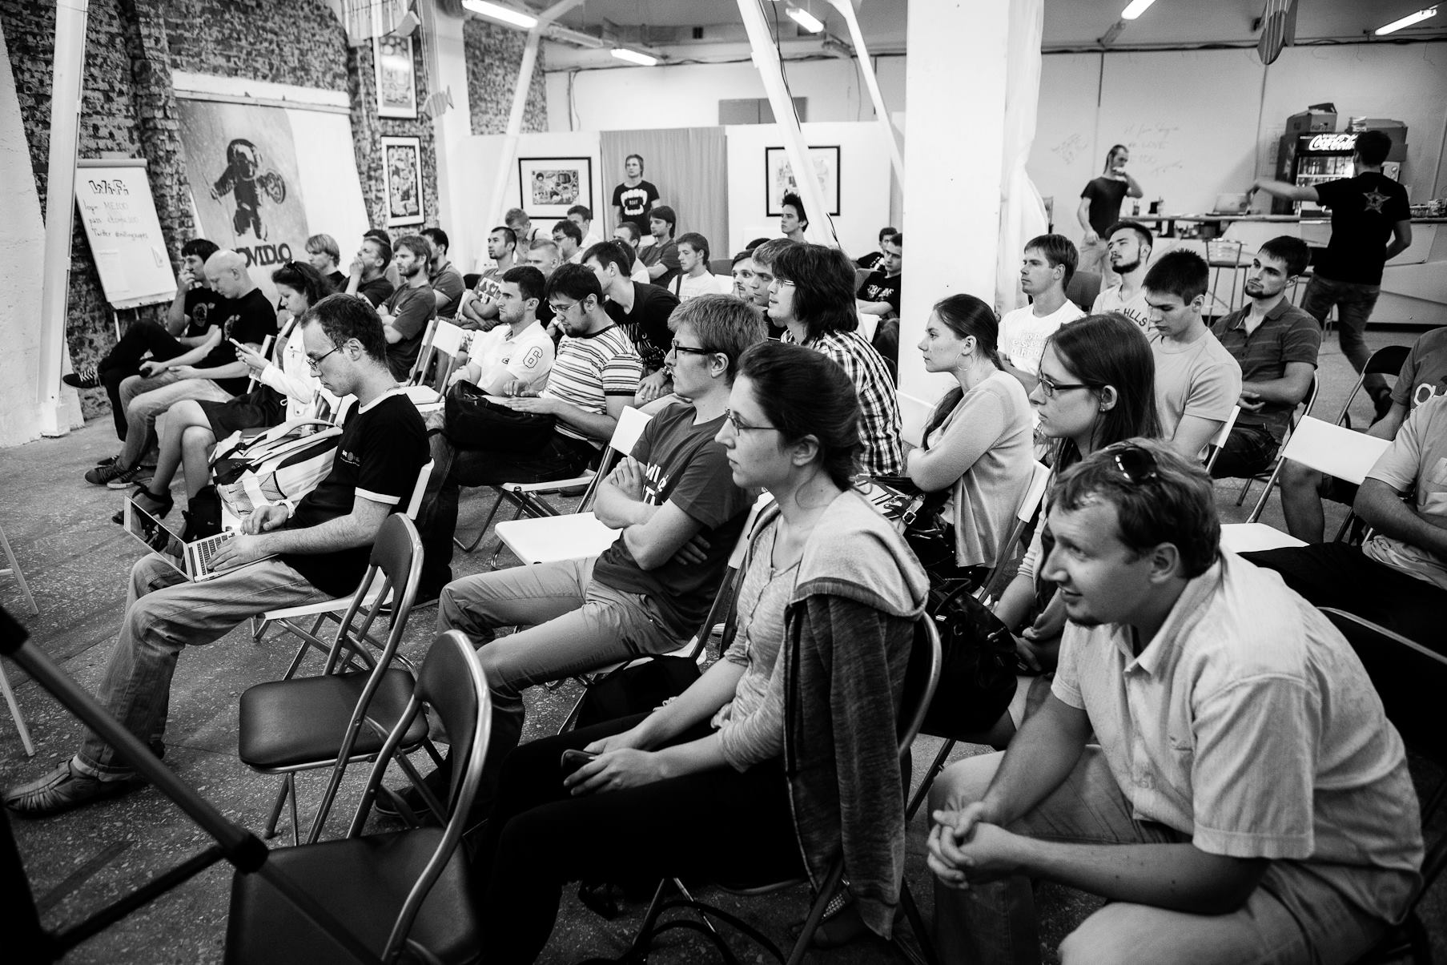
RS #2

Slide 43
Budget?
$150

Slide 44
The Rolling Scopes #2
Venue
Minsk, N58, ME100

Slide 45
Chapter V. Checklist

Slide 46


Slide 47
Tools
Trello
Outlook
Google Docs
Mailchimp

Slide 48
Title
Description
Speaker photo
Final version
Plan
Dry run
Draft
Presentation
one week
one month

Slide 49
TL;DR
https://zachholman.com/talk/the-talk-on-talks/

Slide 50


Slide 51


Slide 52
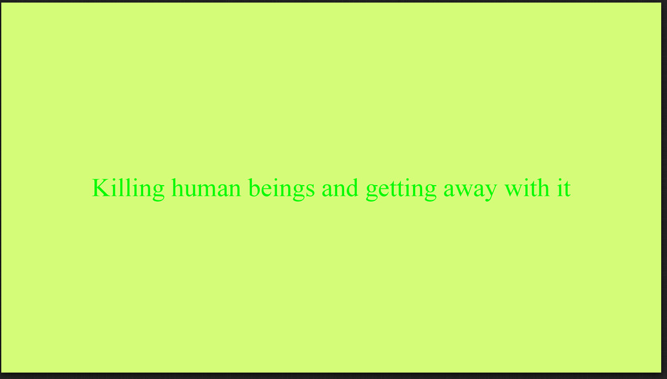

Slide 53


Slide 54


Slide 55


Slide 56


Slide 57


Slide 58


Slide 59


Slide 60
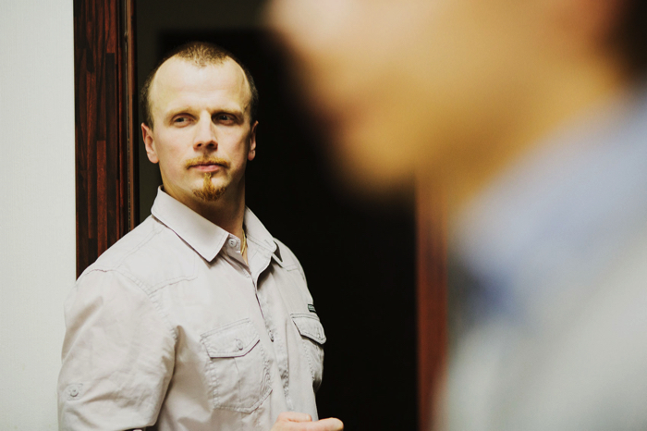
CDP: presentation excellence

Slide 61
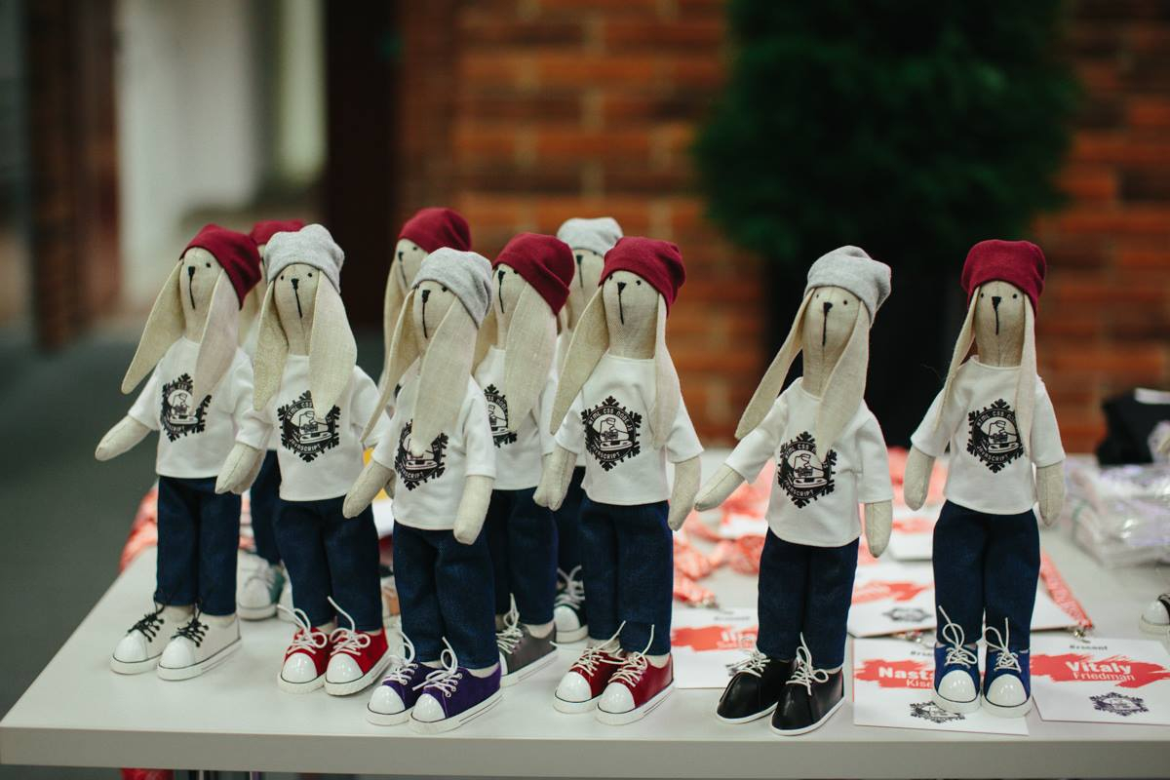

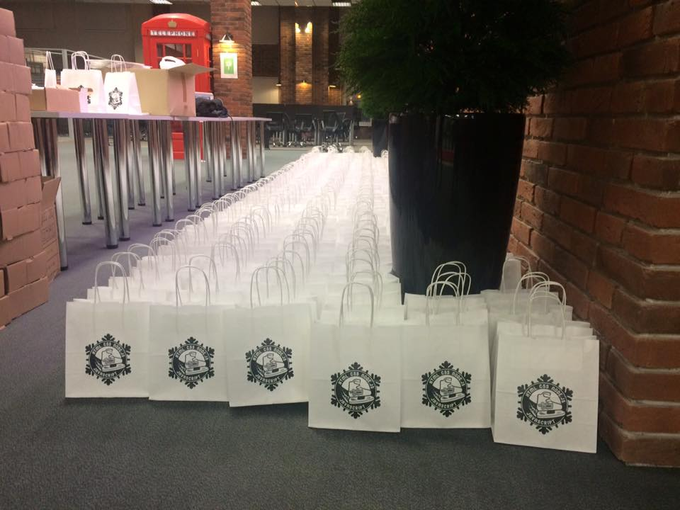
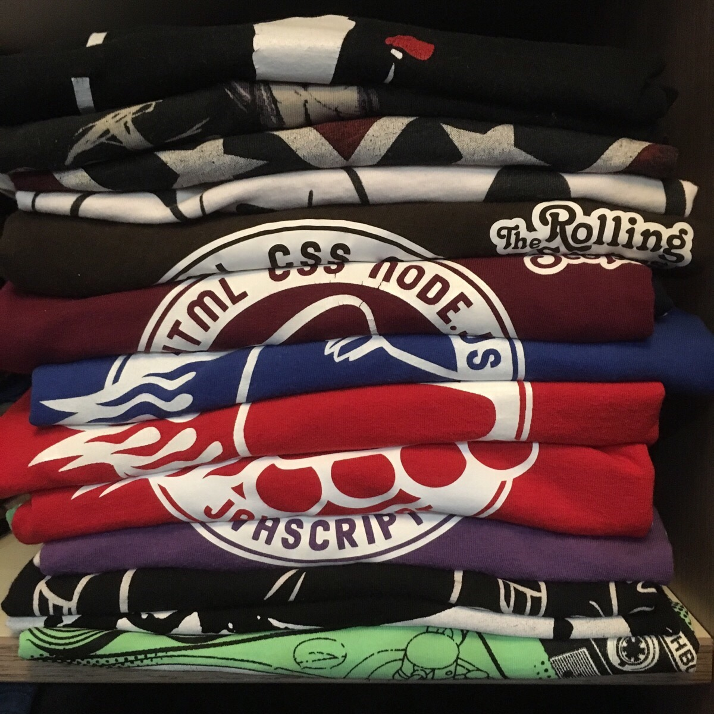
SWAG

Slide 62
Advertisement
1) FB, VK
2) Twitter
3) Lanyard
4) events.dev.by
5) Newsletter
6) Confirmation letter
7) Posters

Slide 63
Registration vs Actual attendance
35% – 85%

Slide 64
RS#23 Gomel

Slide 65
Venue
Chairs, tables, power outlets
Wi-Fi
Air conditioning
Projector resolution/aspect ratio/connector
Wireless Presenter Headset Mic System
Online video broadcasting
Coffee-breaks:
tea/coffee/cookies/cups/
spoons/sugar/boilers for heating water

Slide 66


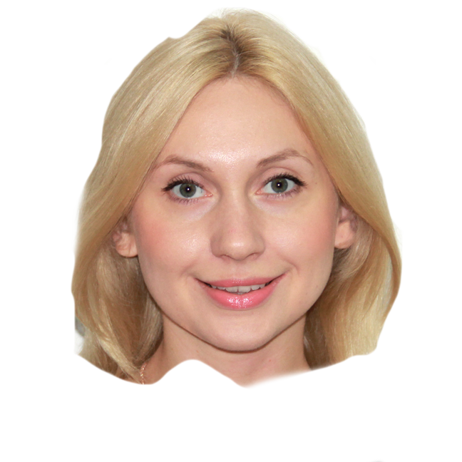

Slide 67
Chapter VI. entertainment

Slide 68
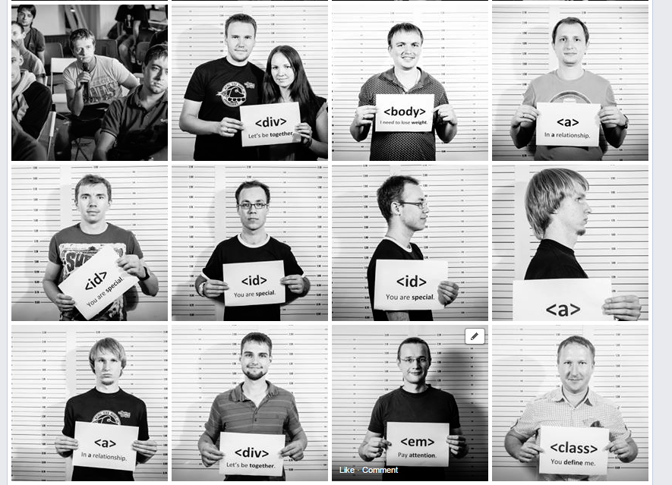
Photozone

Slide 69
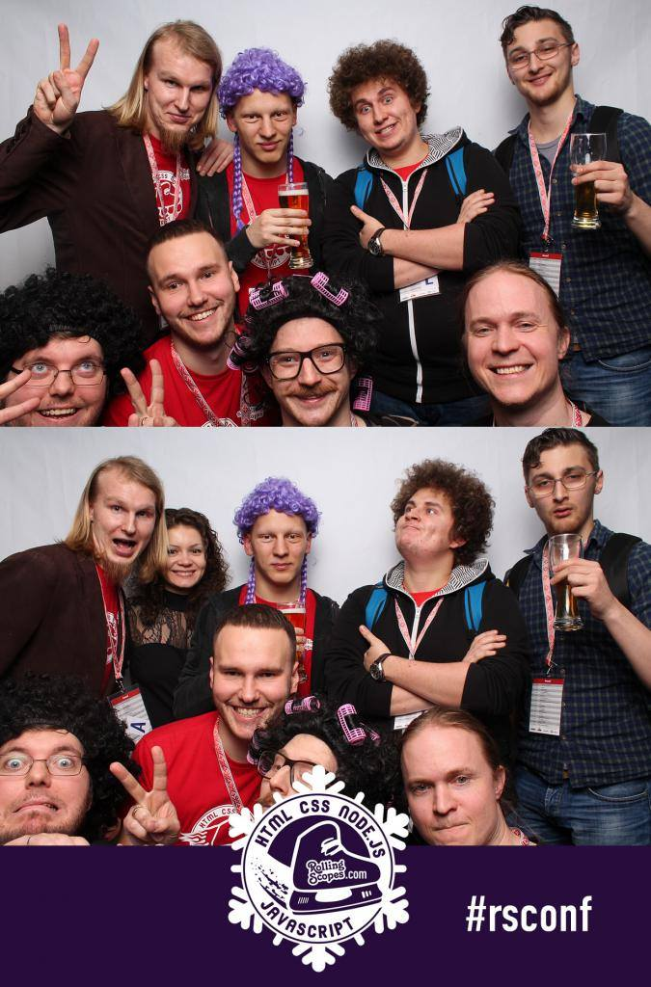
PhotoBOX

Slide 70
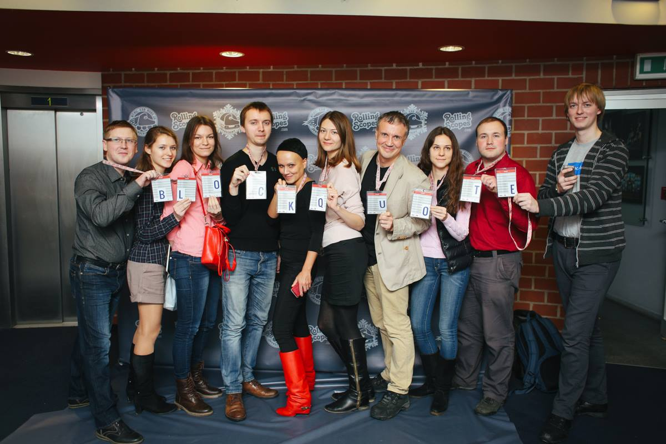


Slide 71
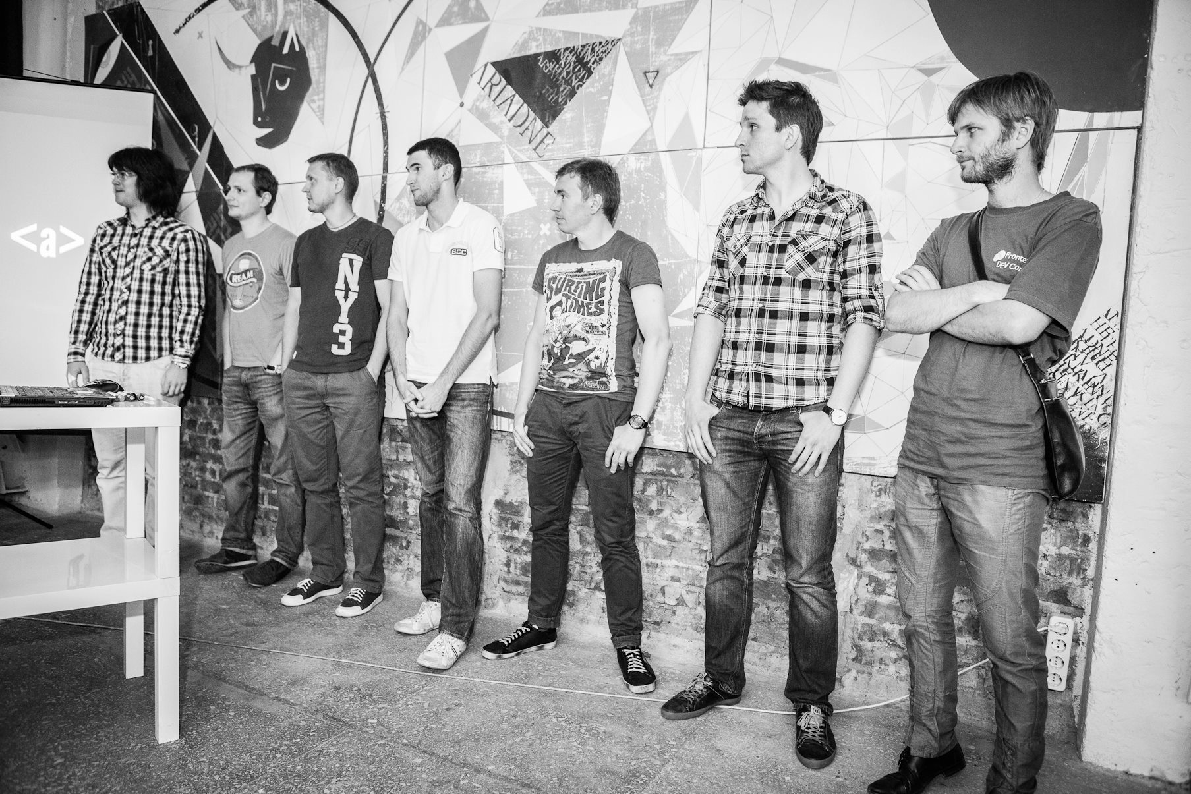
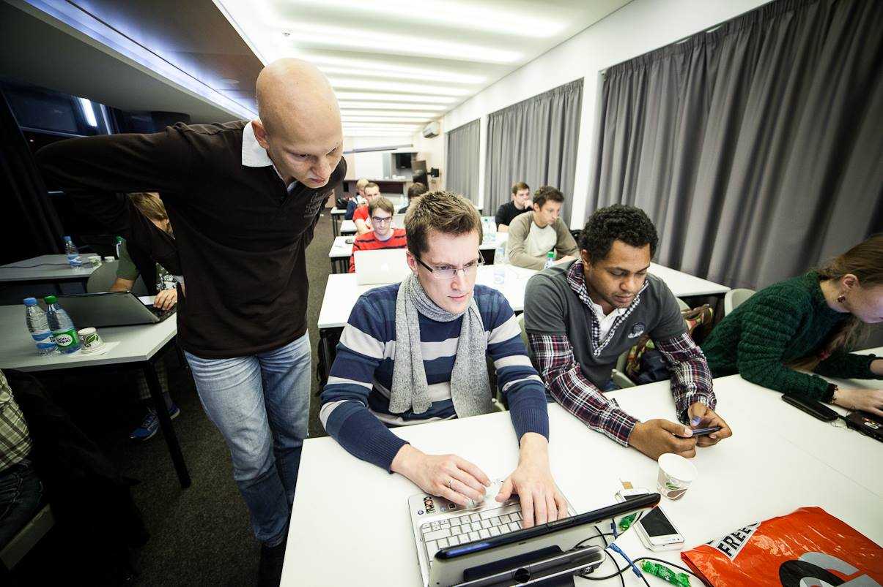
RnJvbnQtZW5kIFF1aXo=

Slide 72
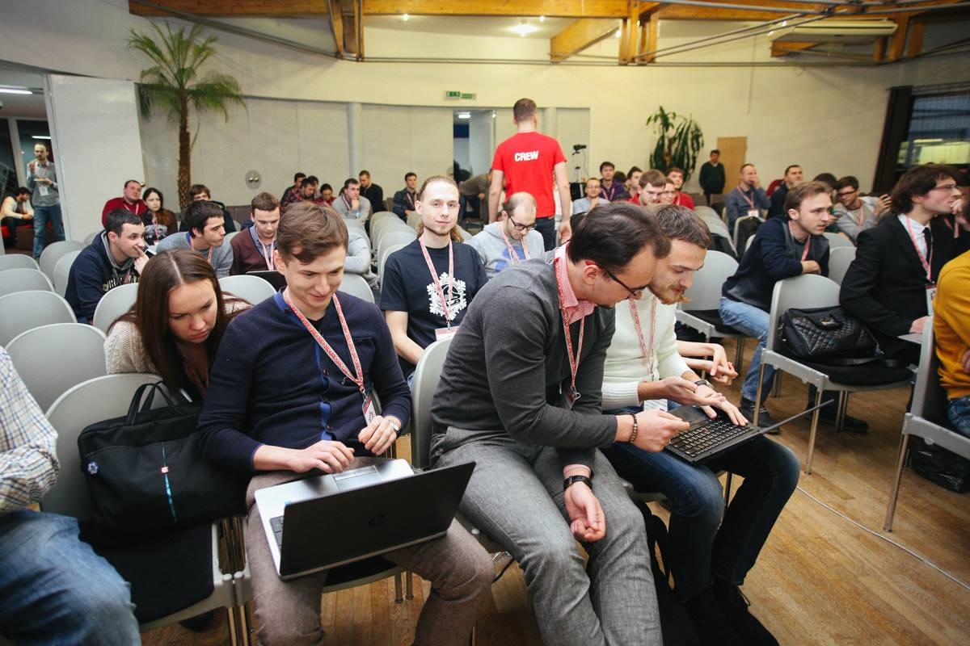
CSS QuickDraw

Slide 73
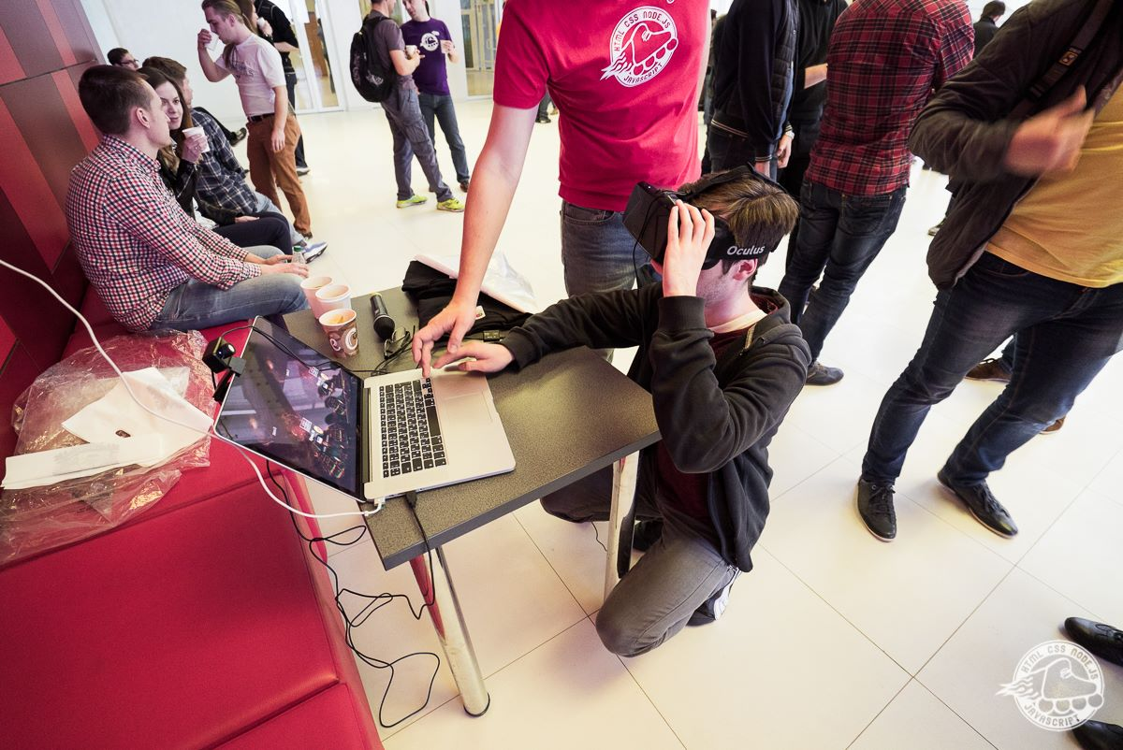
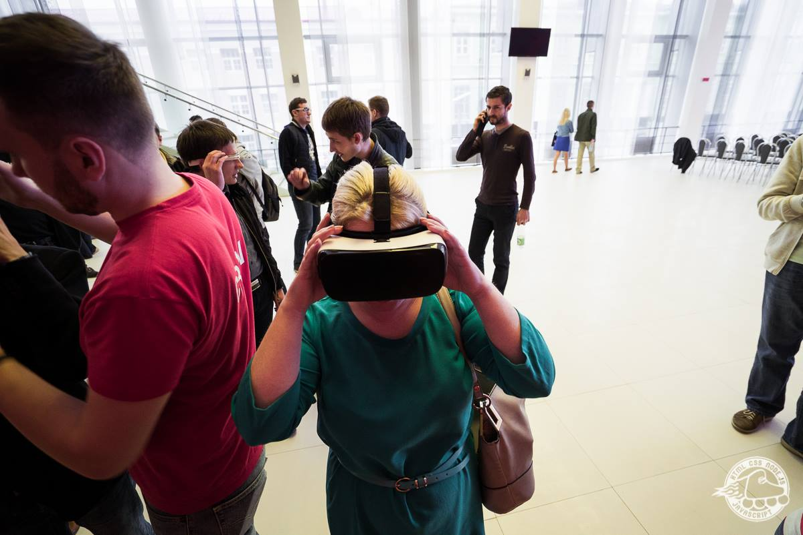
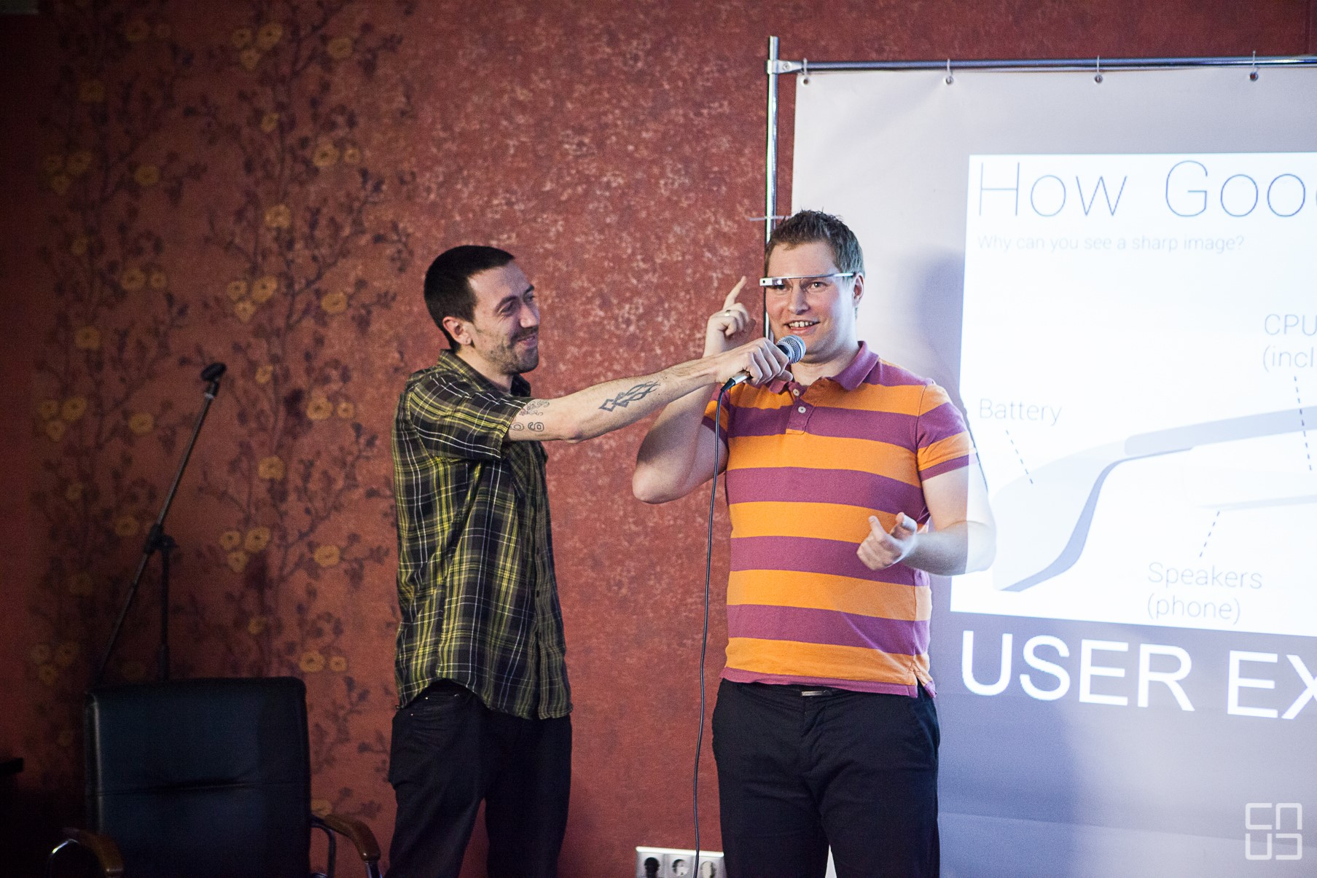

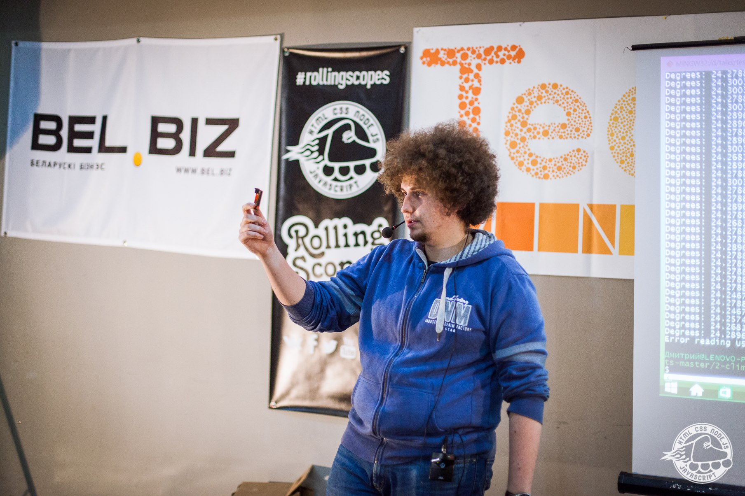
Devices

Slide 75
Diversity

Slide 76
Chapter VII. Feedback

Slide 77
1) жаль что нет соков, т.к. пить один чай надоедает
2) отсутствие гардероба
3) было бы круче проводить это всё в выходные дни.
4) вегетарианская еда
5) Больше мягких сидений
……

Slide 78


Slide 79
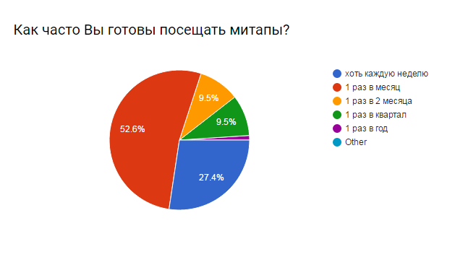

Slide 80


Slide 81


Slide 82
Chapter IIX. RS School

Slide 83


Slide 84


Slide 85


https://school.rollingscopes.com/
71 new students
25 non-degree students
120 p-le passed the exam
600 ppl applied

Slide 86
Open source
https://school.rollingscopes.com/

Slide 87
Chapter IX. #RSConf
THE ROLLING SCOPES CONFERENCE 2016
FEBRUARY 18-21

Slide 89


Slide 90















RSConf2016: Speakers
Kseniya Koltun
Minsk, Belarus
Vitaly Friedman
Freiburg, Germany
Ingvar Stepanyan
London, United Kingdom
Vsevolod Shmyrov
Vladivostok, Russia
Vladimir Petriko
Minsk, Belarus
Gabriel Mičko
Budapest, Hungary
Nastassia Kiseleva
Minsk, Belarus
Konstantin Leyer
Minsk, Belarus
Michael Bodnarchuk
Kiev, Ukraine
Seth Thompson
San Francisco, California
Roman Prudnikov
Novosibirsk, Russia
Martin Naumann
Zurich, Switzerland
Andrey Listochkin
Kiev, Ukraine
Ilja Satchok
Minsk, Belarus
Alexander Gerasimov
Minsk, Belarus

Slide 91



RSConf2016: Oscars for Speakers

Slide 92
RSConf2016: Participants
Participants
400+
Belarus
Russia
Ukraine
Poland
Lithuania

Slide 93



RSConf2016: Satisfaction Survey

Slide 94
RSConf2016: Feedbacks Statistics

Slide 95


RSConf2016: Speakers` Feedbacks

Slide 96



RSConf2016: Insta Feedbacks

Slide 97



RSConf2016: Twitter Feedbacks

Slide 98



Slide 99
Chapter X. how?

Slide 100


Slide 101


Slide 102


Slide 103


Slide 104


Slide 105
Chapter XI. 2018

Slide 106

RS everywhere

Slide 107
THANK
YOU

Slide 108




CONTACT ME
Dzmitry_Varabei@epam.com
Dzmitry_Varabei
https://www.facebook.com/dzmitry.varabei
Notes:
Text should be left aligned / icons should be broken into two columns three and three

